Slide 1
Comparison of Three-Dimensional Supernova Model and Stardust Compositions
Els Shepard
Mentor: Dr. Maitrayee Bose
ASU School of Earth and Space Exploration
19 April 2025

Slide 2
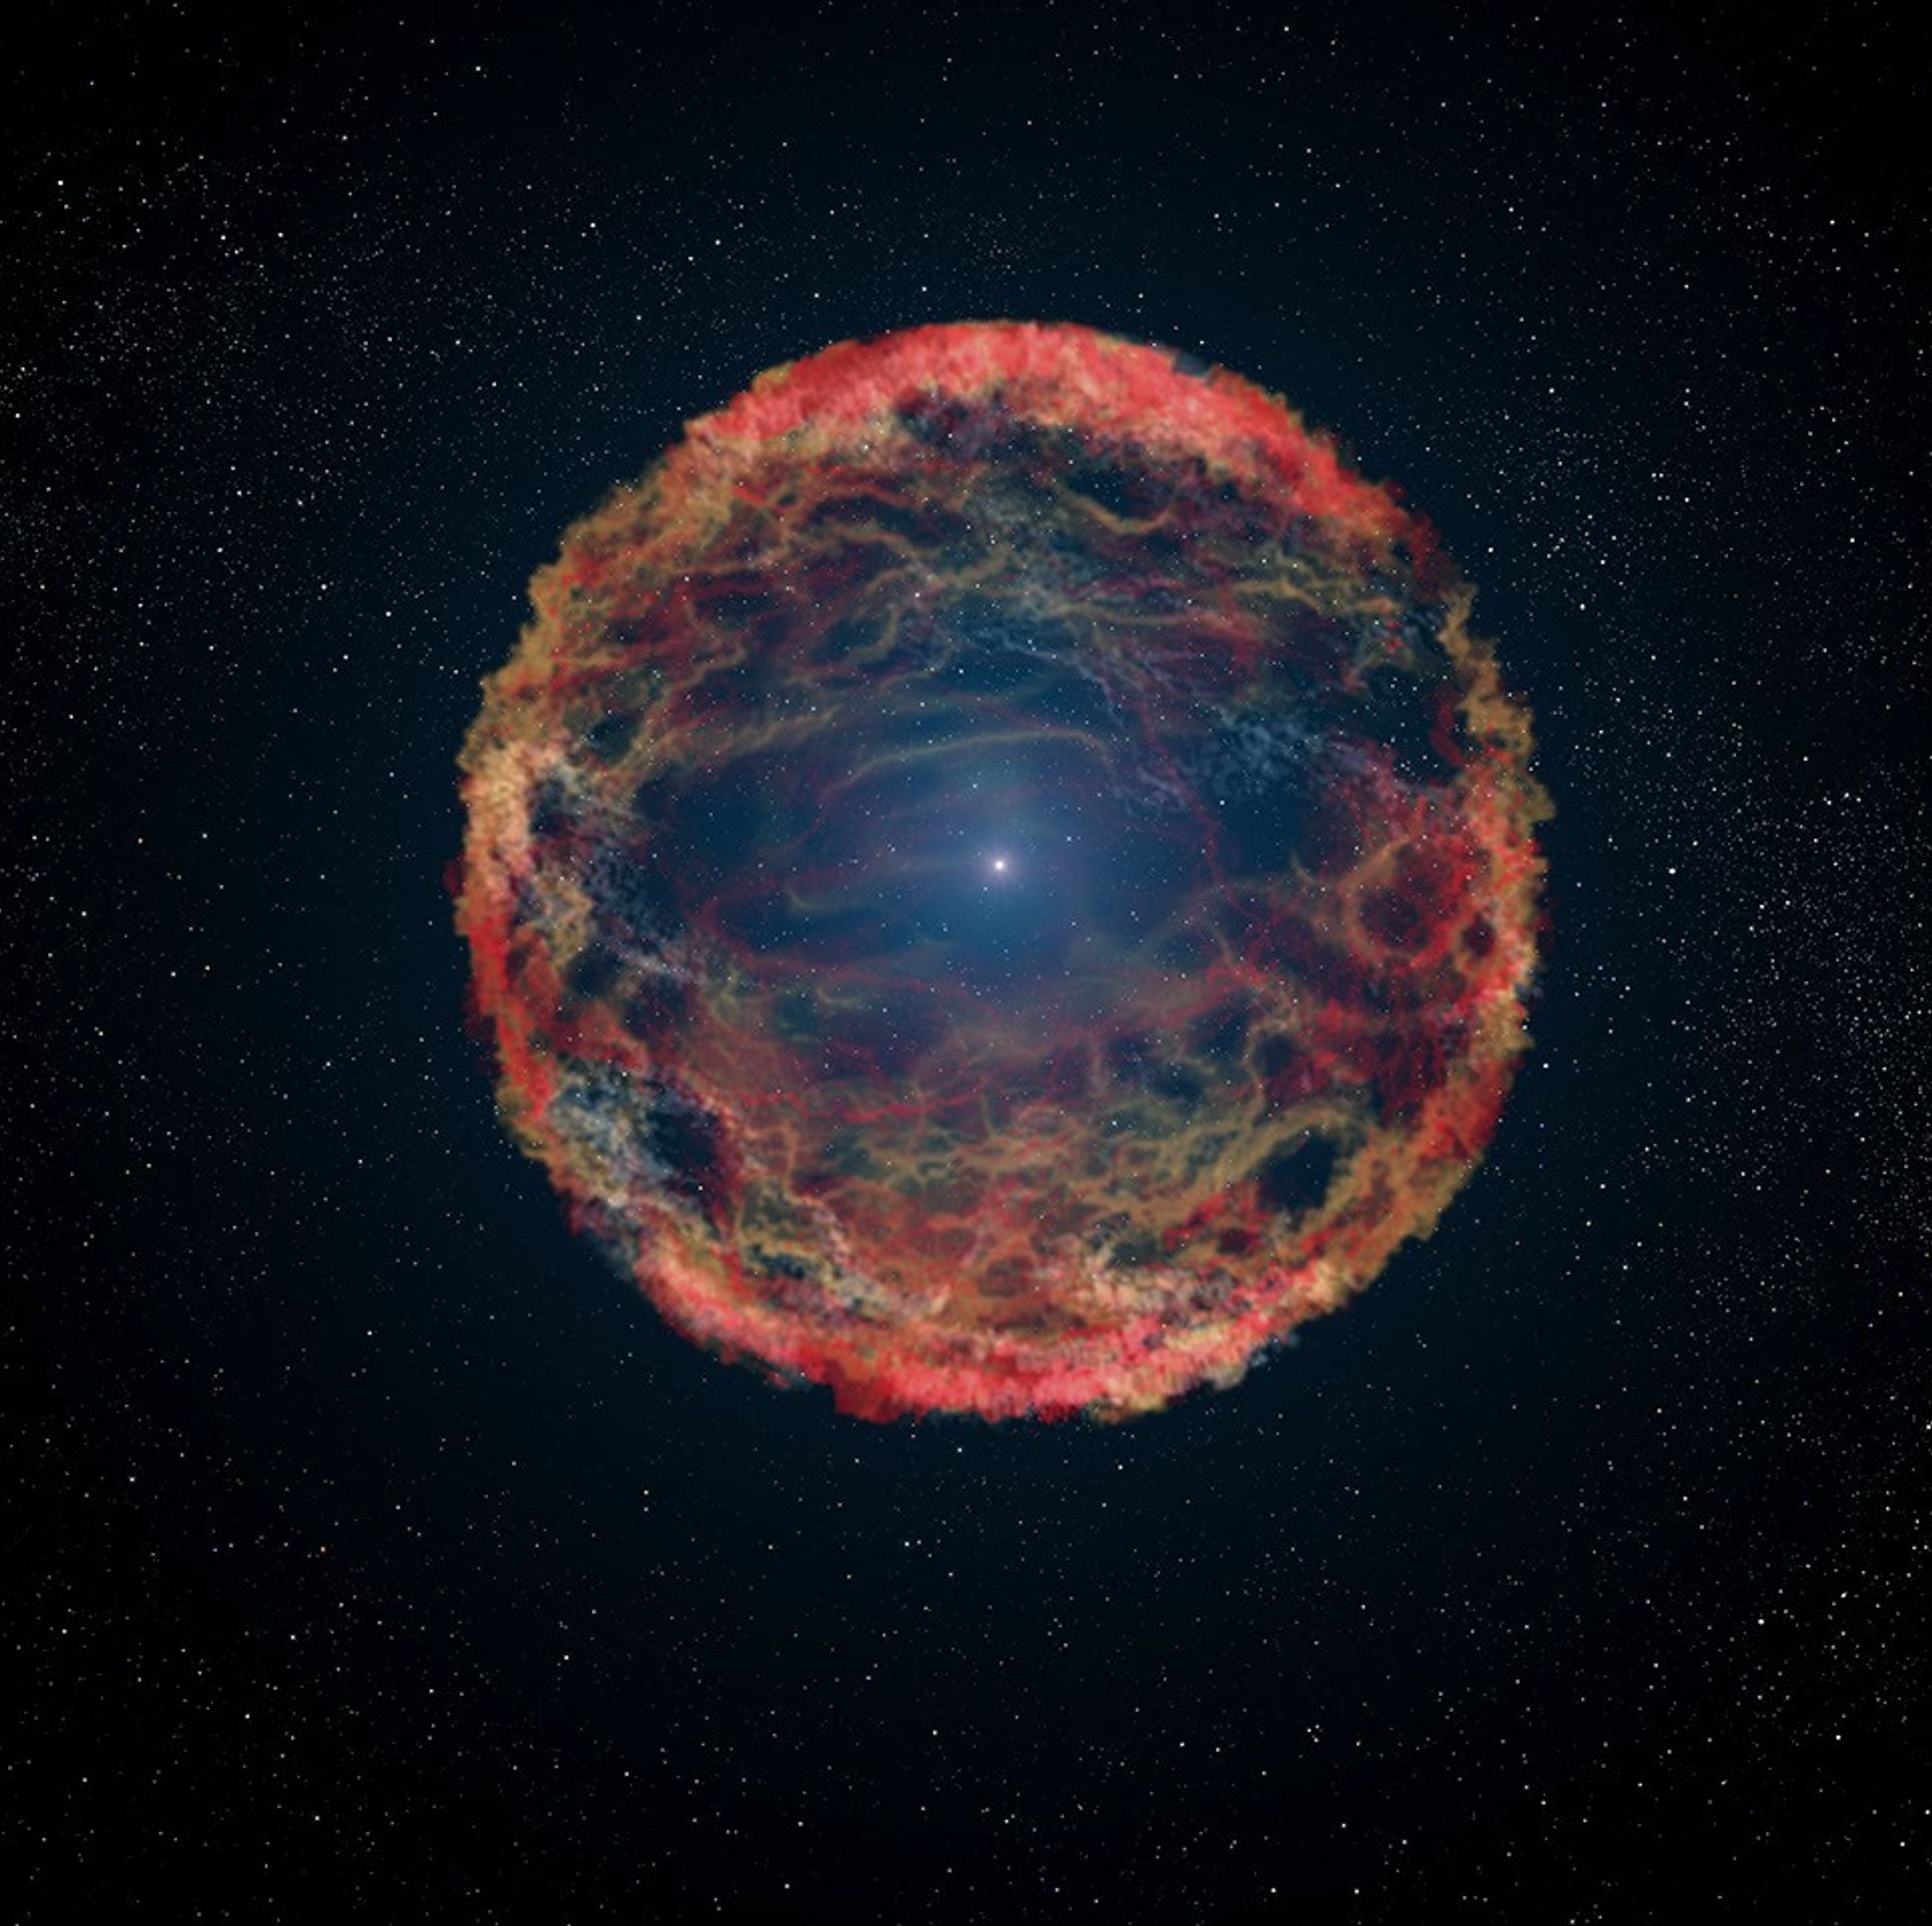
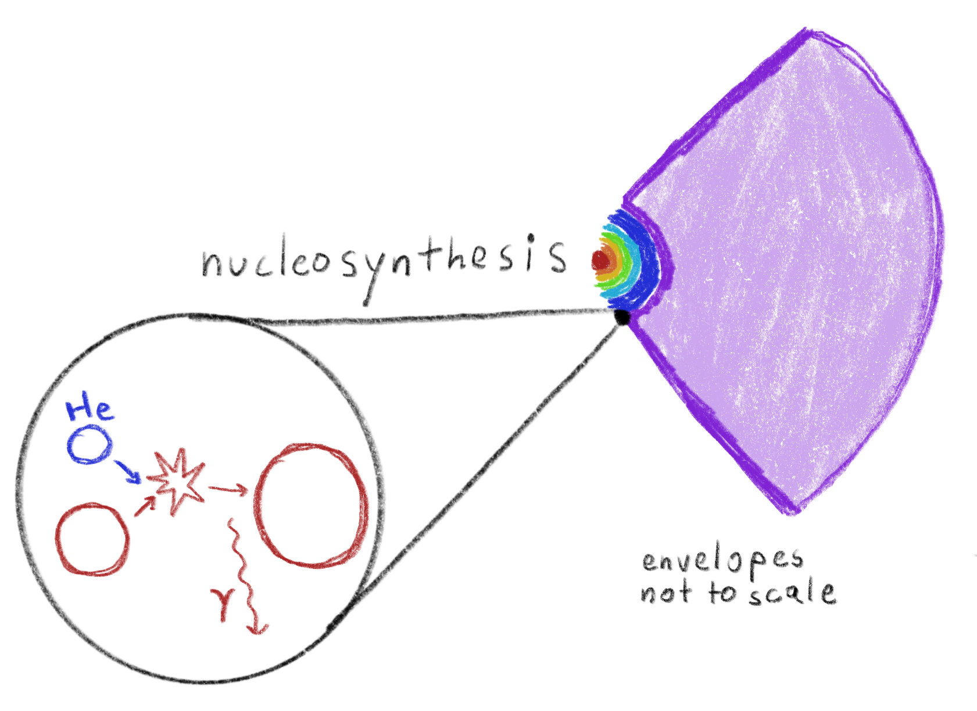
Background - Supernovae
Explosion of massive progenitor star
CCSN: Core collapses,
explosion triggers nucleosynthesis,
scatters elements
Images: NASA/CXC/MIT/L.Lopez et al/Palomar/NSF/NRAO/VLA.
NASA/ESA/G.Bacon (STScI).
Notes:
A star’s core can only fuse up to Fe; further fusion requires energy rather than producing it.
During a CCSN, which is >10 Msun, explosion energy outwards triggers nucleosynthesis in the outer envelope of the star; lots of fusion occurs and heavier elements are created.

Slide 3
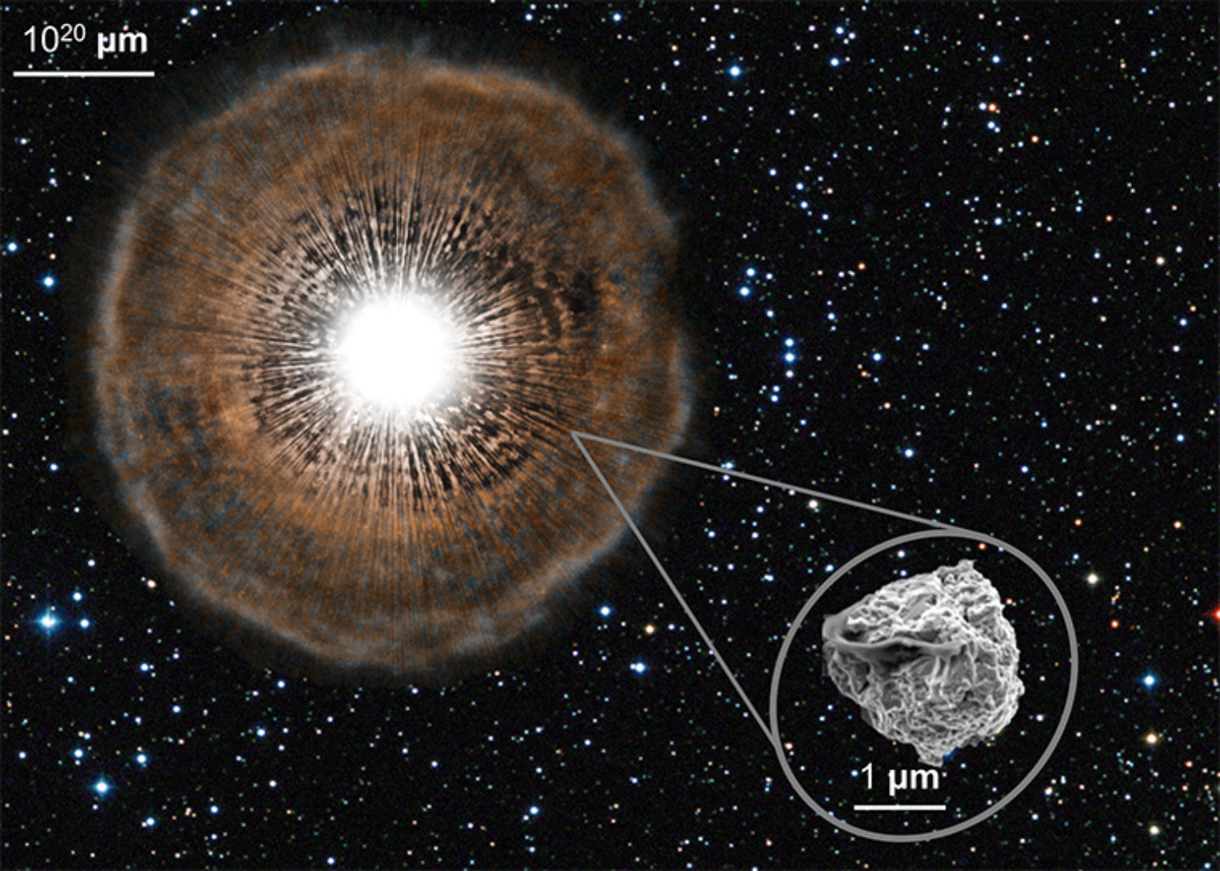
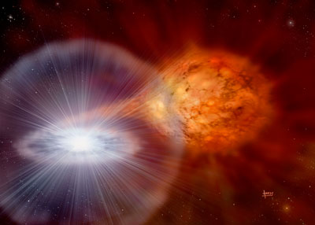
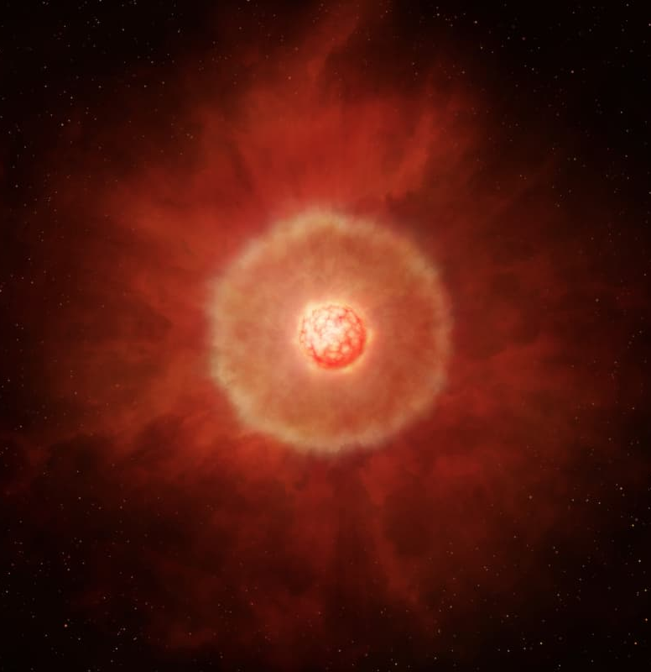

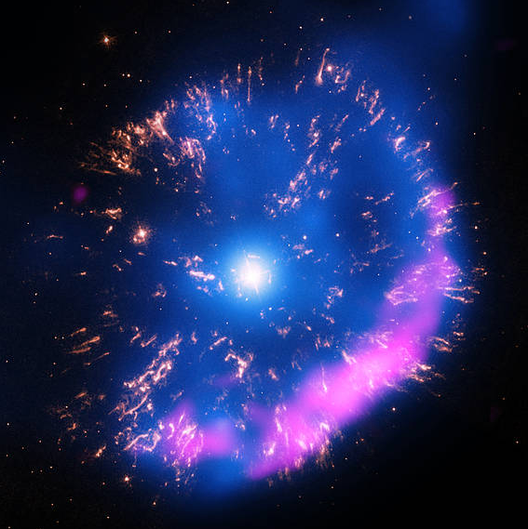
Background – Stardust
Tiny grains from interstellar space
Low abundance
Other sources:
Images: NASA, N. Liu, A. Davis.
David A. Hardy
Miyata, Tachinabana, et al.
NASA Chandra X-ray Observatory.
Type 1a SN
AGB Star
Nova
Notes:
Grains outflowing from supernovae are called stardust, and we can find them in meteorites. Stardust can also come from AGB star outflows, nova bursts, or other types of supernovae.
We can find them condensed in meteorites, micrometeorites, or sample returns. They are very tiny, at the micron scale. What they have in common is they all formed before our sun. We study their compositions to determine their source, and learn about how elements are dispersed in space.

Slide 4

Methods
Four 3D Supernova models:
Stardust grains:
Oxide and Silicate grains
Previously assumed low-mass star origin
Anomalous Mg isotope compositions
Progenitor Star Mass | Symmetry
15 M☉ | 3D convection model
20 M☉ | Asymmetric
15 M☉ | Symmetric
15 M☉ | Asymmetric
From isotope data, calculate relative enrichment:
From 3D coordinates, calculate radius from core:
Notes:
Historically, 1D models have been used to analyze supernova chemistry. We use four 3D models, which we’ll get into in a minute.
For stardust grains, we consider oxide and silicate grains enriched in oxygen 17, which are thought to originate in low mass stars. New and improved instrumentation for measuring stardust grains has shown high confidence in anomalous magnesium isotope enrichments and depletions, which likely could not have formed in low mass stars. This is why we are investigating supernovae as a potential source.
To calculate relative enrichment of isotopes…
We also calculate radius from the center of the star’s core in 3D.

Slide 5
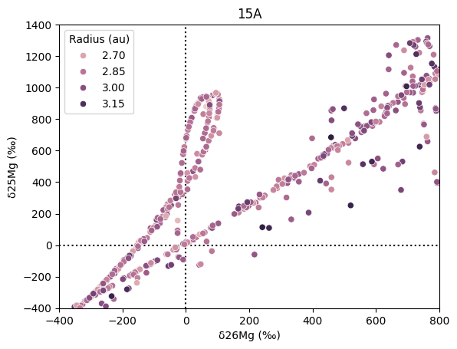


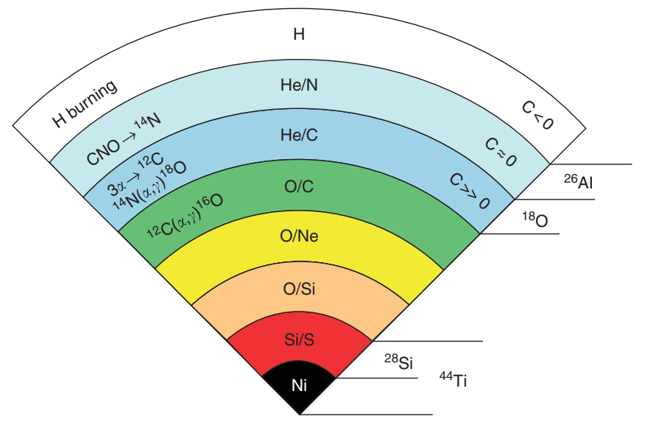
Results - Radius
Solar
15 M☉ Asymmetric
Simple radius alone is not a clear indicator of Mg isotopic composition.
(Similar results for all models)
Solar
Image: Woosley, Weaver (1995).
Notes:
Main point: core is assumed to be concentric with elemental concentrations
Hydrogen envelope is LARGE

Slide 6
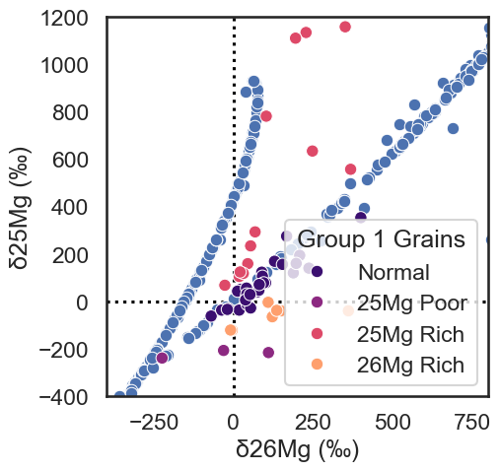
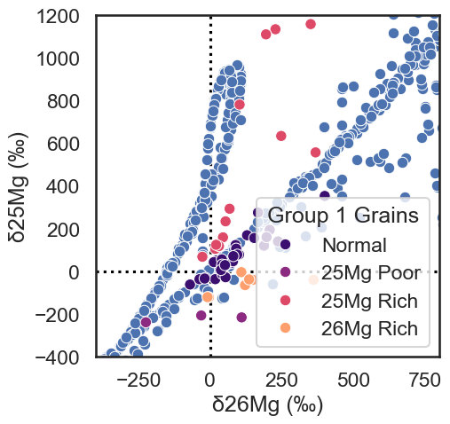
15 M☉ Symmetric
Solar
Solar
Results – Grain Comparison
15 M☉ Asymmetric
Solar
Solar
15 M☉ Asymmetric model provides the best fit with anomalous group 1 grains for magnesium delta values.

Slide 7
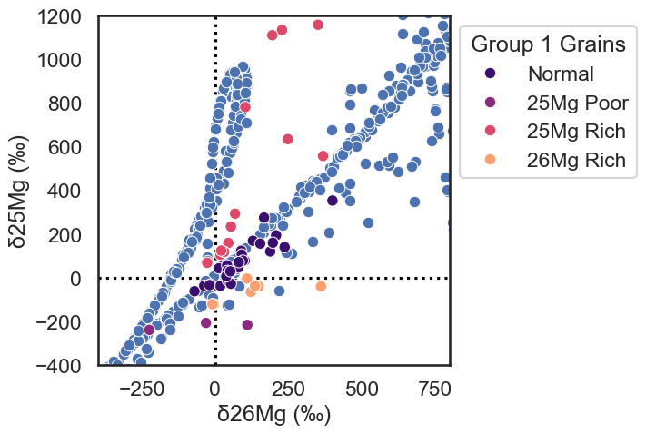

Results Summary
Solar
15 M☉ Asymmetric
Different progenitor star and 3D explosion conditions result in different delta values in the ejecta.
Some magnesium isotope delta values for anomalous stardust grains match with the 15 M☉ Asymmetric SN model.
Solar
Questions?
Connect:
elshepar@asu.edu

Slide 8

References
Peter Hoppe et al 2021, The Astrophysical Journal. 913 10
Jack Schulte et al 2021, The Astrophysical Journal. 908 38
Katherine Lodders 2020, Solar Elemental Abundances, The Oxford Research Encyclopedia of Planetary Science.
Acknowledgements
Mentor: Dr. Maitrayee Bose, ASU SESE
3D Supernova models: Dr. Patrick Young, ASU SESE
Center for Isotope Analysis, ASU
Cameron Brooks ‘24
Supported in part through the Arizona NASA Space Grant Consortium, Cooperative Agreement 80NSSC20M0041.

